Slide 1
Dynamic Programming: MCM
CSE 301: Combinatorial Optimization

Slide 2
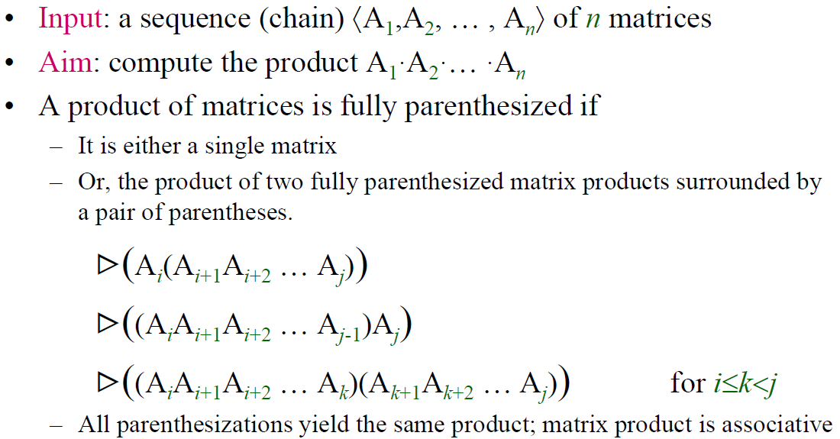
Matrix-chain Multiplication

Slide 3
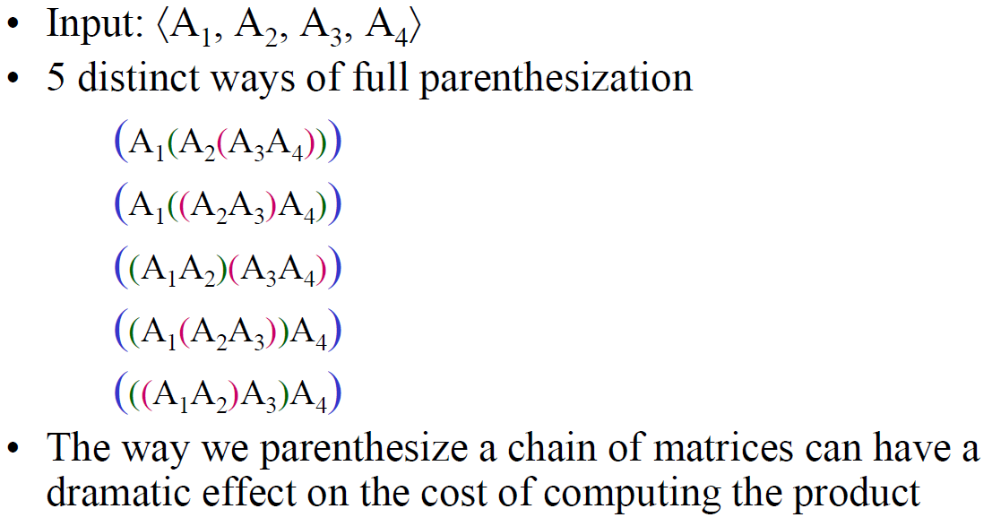
Matrix-chain Multiplication

Slide 4
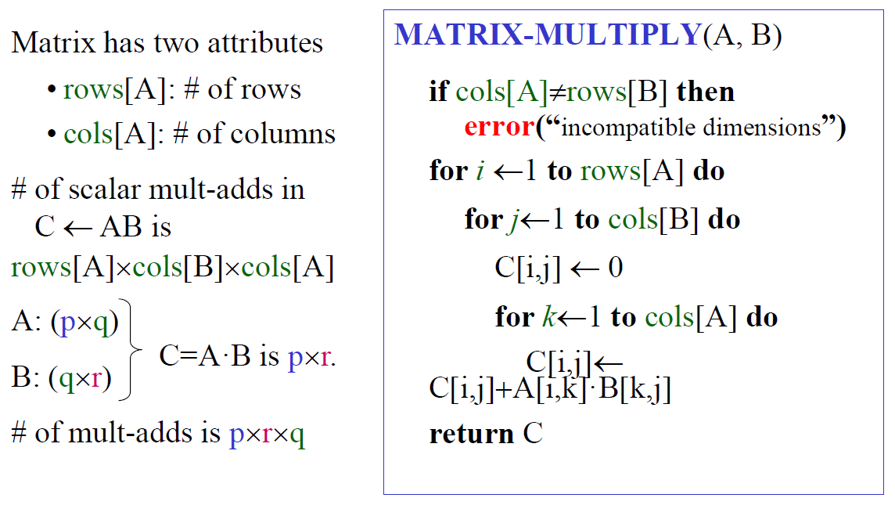
Matrix-chain Multiplication
Cost of Multiplying two Matrices

Slide 5
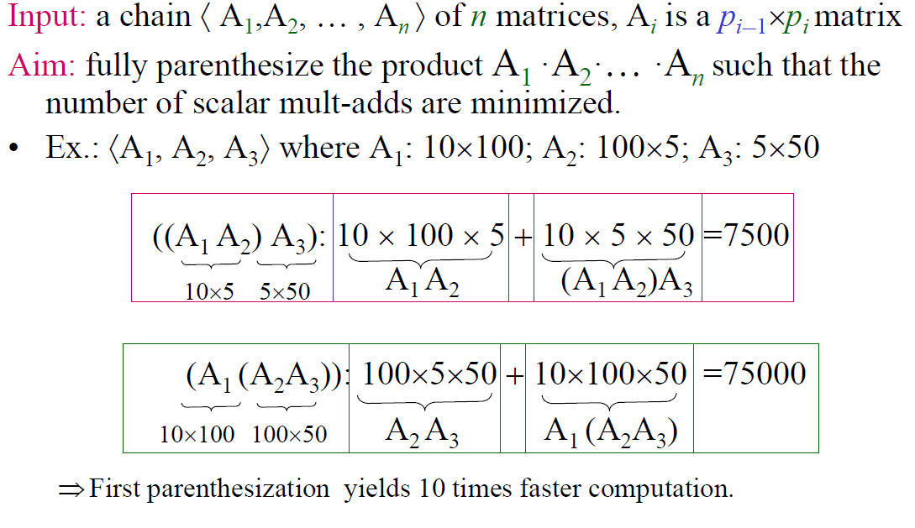
Matrix-chain Multiplication

Slide 6
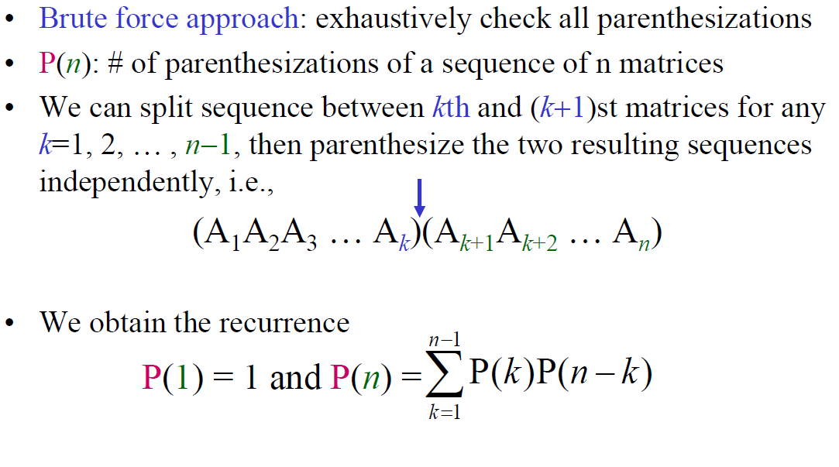
Number of Parenthesizations

Slide 7
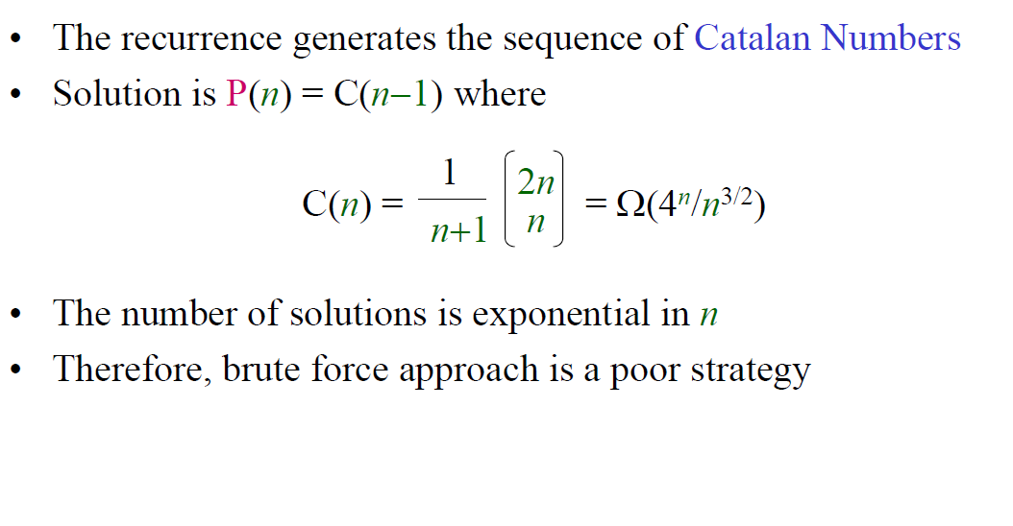
Number of Parenthesizations

Slide 8
Establishing the Recurrence
Consider the subproblem of parenthesizing
A_{i…j} = A_{i} A_{i+1} ⋅⋅⋅ A_{j} for 1 ≤ i ≤ j ≤ n
= A_{i…k} A_{k+1…j} for i ≤ k < j
Assume that the optimal parenthesization splits the product A_{i} A_{i+1} ⋅⋅⋅ A_{j} at k (i ≤ k < j)
m[i, j] =
p_{i-1}p_{k}p_{j}
m[i, k]
m[k+1,j]
m[i, k] + m[k+1, j] + p_{i-1}p_{k}p_{j}
min # of scalar
multiplications
to compute A_{i…k}
min # of multiplications
to compute A_{k+1…j}
# of multiplications
to compute A_{i…k}A_{k+1…j}

Slide 9
The Recurrence relation
0 if i = j
m[i, j] = min {m[i, k] + m[k+1, j] + p_{i-1}p_{k}p_{j}} if i < j
^{i≤k<j}

Slide 10
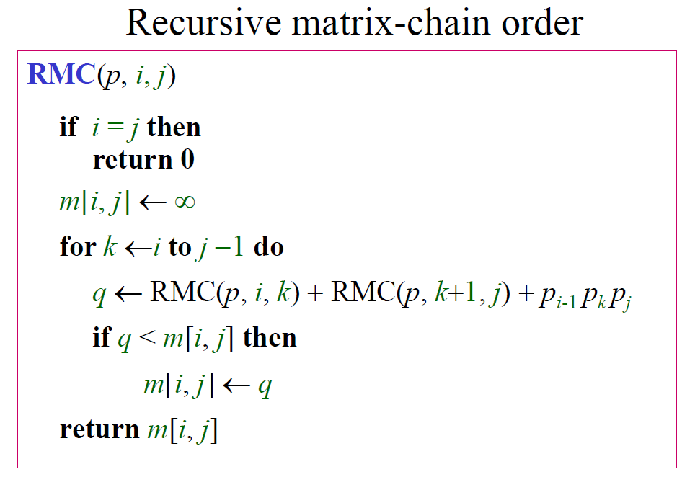
Recursive Matrix-chain

Slide 11
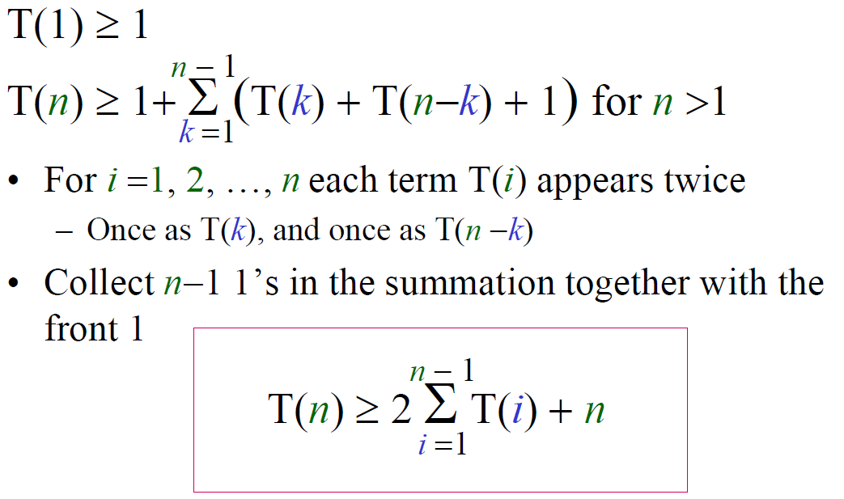
Running Time of Recursive Matrix-chain
Prove via substitution that T(n) is Ω(2^{n})

Slide 12
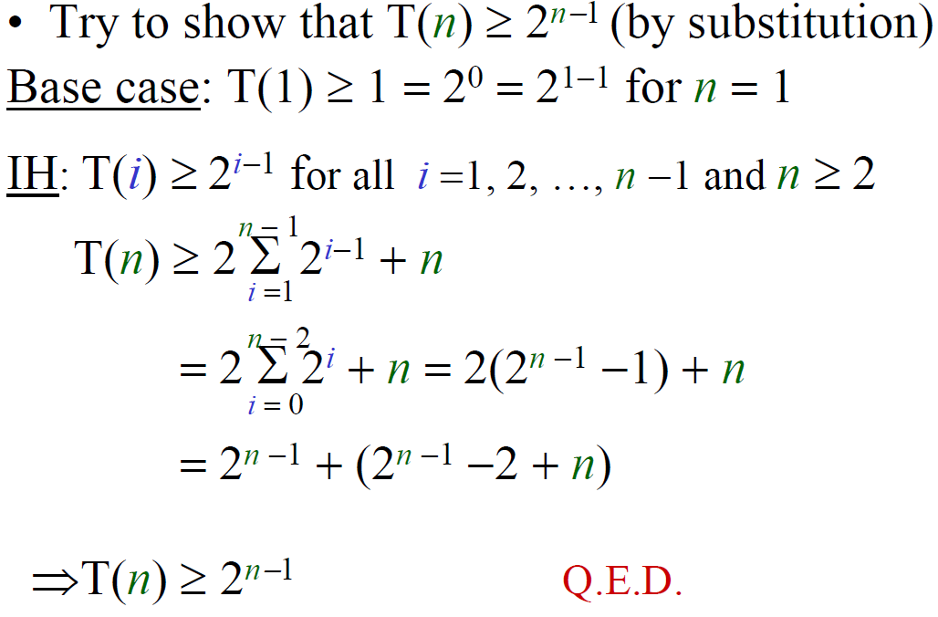
Running Time of Recursive Matrix-chain
induction

Slide 13
Elements of Dynamic Programming
When should we look for a DP solution to an optimization problem?
Two key ingredients for the problem
Optimal substructure
Overlapping subproblems

Slide 14
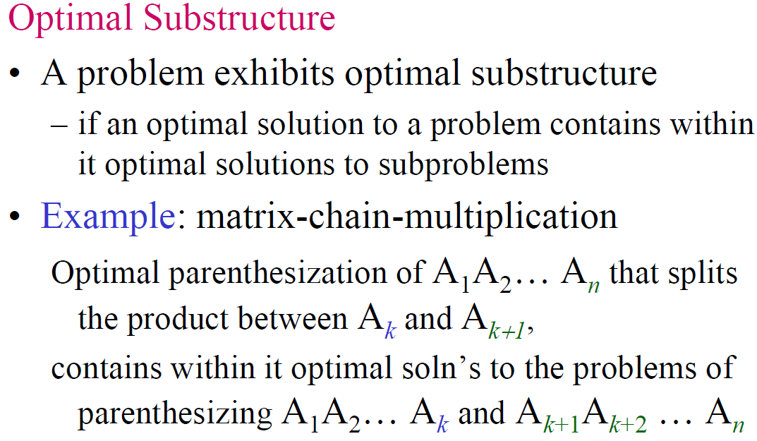
Elements of Dynamic Programming
0 if i = j
m[i, j] = min {m[i, k] + m[k+1, j] + p_{i-1}p_{k}p_{j}} if i < j
^{i≤k<j}

Slide 15
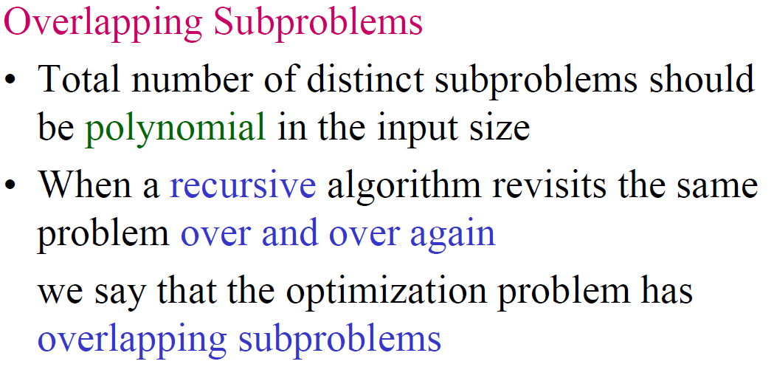
Elements of Dynamic Programming

Slide 16
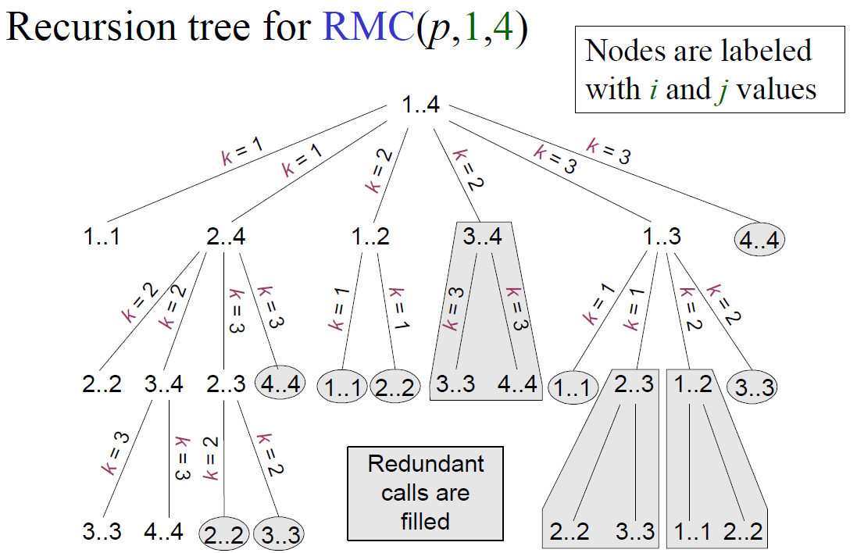
Overlapping Subproblems in RMC Execution

Slide 17
Using Dynamic Programming
0 if i = j
m[i, j] = min {m[i, k] + m[k+1, j] + p_{i-1}p_{k}p_{j}} if i < j
^{i≤k<j}
Length = 1: i = j, i = 1, 2, …, n
Length = 2: j = i + 1, i = 1, 2, …, n-1
1
2
3
n
1
m[1, n] gives the optimal
solution to the problem
2
3
i
Compute rows from diagonal to top and from left to right
In a similar matrix s, we keep the optimal values of k
n
second
j
first

Slide 18
Matrix-Chain-Order
Alg.: MATRIX-CHAIN-ORDER(p)
n = p.length-1
let m[1..n, 1..n] and s[1..n-1, 2..n] be new tables
for i = 1 to n
m[i, i] = 0
for l = 2 to n
for i = 1 to n – l + 1
j = i + l – 1
m[i, j] = ∞
for k = i to j – 1
q = m[i, k] + m[k+1, j] + p_{i-1}p_{k}p_{j}
if q < m[i, j]
m[i, j] = q
s[i, j] = k
return m and s

Slide 19
Analysis
Our algorithm computes the minimum-cost table m and the split table s
The optimal solution can be constructed from the split table s (shown later)
Each entry s[i, j ]=k shows where to split the product A_{i} A_{i+1} … A_{j} for the minimum cost
There are 3 nested loops and each can iterate at most n times, so the total running time is Θ(n³).

Slide 20
Example:
p = (10, 5, 1, 10, 2, 10)
[10×5]×[5×1]×[1×10]×[10×2]×[2×10]
1
2
3
4
5
1
2
3
4
5
1
1
2
2
3
3
4
4
5
5
m(i,j), i ≤ j
s(i,j), i ≤ j

Slide 21
Example:
p = (10, 5, 1, 10, 2, 10)
[10×5]×[5×1]×[1×10]×[10×2]×[2×10]
m(i,i) = 0
1
2
3
4
5
1
2
3
4
5
1
0
1
2
0
2
3
0
3
4
0
4
5
0
5
m(i,j), i ≤ j
s(i,j), i ≤ j

Slide 22
Example:
p = (10, 5, 1, 10, 2, 10)
[10×5]×[5×1]×[1×10]×[10×2]×[2×10]
m(i,i+1) = p_{i-1}p_{i}p_{i+1} e.g., m(2,3) = p₁p₂p₃ = 5*1*10 = 50, m(1,2)=10*5*1 = 50, m(3,4) = 1*10*2=20, …
s(i,i+1) = i
1
2
3
4
5
1
2
3
4
5
1
0
50
1
1
2
0
50
2
2
3
0
20
3
3
4
0
200
4
4
5
0
5
m(i,j), i ≤ j
s(i,j), i ≤ j

Slide 23
Example:
p = (10, 5, 1, 10, 2, 10)
[10×5]×[5×1]×[1×10]×[10×2]×[2×10]
m(i,i+2) = min{m(i,i) + m(i+1,i+2) + p_{i-1}p_{i}p_{i+2},
m(i,i+1) + m(i+2,i+2) + p_{i-1}p_{i+1}p_{i+2}}
1
2
3
4
5
1
2
3
4
5
1
0
50
1
1
2
0
50
2
2
3
0
20
3
3
4
0
200
4
4
5
0
5
m(i,j), i ≤ j
s(i,j), i ≤ j

Slide 24
Example:
p = (10, 5, 1, 10, 2, 10)
[10×5]×[5×1]×[1×10]×[10×2]×[2×10]
m(2,4) = min{m(2,2) + m(3,4) + p₁p₂p₄, m(2,3) + m(4,4) + p₁p₃p₄}
= min{0+20+5*1*2, 50+0+5*10*2} = 30
1
2
3
4
5
1
2
3
4
5
1
0
50
150
1
1
2
2
0
50
30
2
2
2
3
0
20
40
3
3
3
4
0
200
4
4
5
0
5
m(i,j), i ≤ j
s(i,j), i ≤ j

Slide 25
Example:
[10×5]×[5×1]×[1×10]×[10×2]×[2×10]
m(i,i+3) = min{m(i,i) + m(i+1,i+3) + p_{i-1}p_{i}p_{i+3},
m(i,i+1) + m(i+2,i+3) + p_{i-1}p_{i+1}p_{i+3,}
m(i,i+2) + m(i+3,i+3) + p_{i-1}p_{i+2}p_{i+3}}
1
2
3
4
5
1
2
3
4
5
1
0
50
150
90
1
1
2
2
2
0
50
30
90
2
2
2
2
3
0
20
40
3
3
3
4
0
200
4
4
5
0
5
m(i,j), i ≤ j
s(i,j), i ≤ j

Slide 26
Example:
[10×5]×[5×1]×[1×10]×[10×2]×[2×10]
m(i,i+4) = min{m(i,i) + m(i+1,i+4) + p_{i-1}p_{i}p_{i+4},
m(i,i+1) + m(i+2,i+4) + p_{i-1}p_{i+1}p_{i+4,} m(i,i+2) + m(i+3,i+4) + p_{i-1}p_{i+2}p_{i+4,} m(i,i+3) + m(i+4,i+4) + p_{i-1}p_{i+3}p_{i+4}}
1
2
3
4
5
1
2
3
4
5
1
0
50
150
90
190
1
1
2
2
2
2
0
50
30
90
2
2
2
2
3
0
20
40
3
3
3
4
0
200
4
4
5
0
5
m(i,j), i ≤ j
s(i,j), i ≤ j

Slide 27
Print optimal parenthesis
Alg.: PRINT-OPTIMAL-PARENS(s, i, j)
if i == j
print “A_{i}”
else print “(”
PRINT-OPTIMAL-PARENS(s, i, s[i, j])
PRINT-OPTIMAL-PARENS(s, s[i, j] + 1, j)
print “)”

Slide 28
Example:
Optimal multiplication sequence
s(1,5) = 2
▶ A₁₅ = A₁₂×A₃₅
1
2
3
4
5
1
2
3
4
5
1
0
50
150
90
190
1
1
2
2
2
2
0
50
30
90
2
2
2
2
3
0
20
40
3
3
3
4
0
200
4
4
5
0
5
m(i,j), i ≤ j
s(i,j), i ≤ j

Slide 29
Example:
A₁₅ = A₁₂×A₃₅
s(1,2) = 1 ▶ A₁₂ = A₁₁×A₂₂
→ A₁₅ = (A₁₁×A₂₂)×A₃₅
1
2
3
4
5
1
2
3
4
5
1
0
50
150
90
190
1
1
2
2
2
2
0
50
30
90
2
2
2
2
3
0
20
40
3
3
4
4
0
200
4
4
5
0
5
m(i,j), i ≤ j
s(i,j), i ≤ j

Slide 30
Example:
A₁₅ = (A₁₁×A₂₂)×A₃₅
s(3,5) = 4 ▶ A₃₅ = A₃₄×A₅₅
→ A₁₅ = (A₁₁×A₂₂)×(A₃₄×A₅₅)
1
2
3
4
5
1
2
3
4
5
1
0
50
150
90
190
1
1
2
2
2
2
0
50
30
90
2
2
2
2
3
0
20
40
3
3
4
4
0
200
4
4
5
0
5
m(i,j), i ≤ j
s(i,j), i ≤ j

Slide 31
Example:
A₁₅ = (A₁₁×A₂₂)×(A₃₄×A₅₅)
s(3,4) = 3 ▶ A₃₄ = A₃₃×A₄₄
→ A₁₅ = (A₁₁×A₂₂)×((A₃₃×A₄₄)×A₅₅)
1
2
3
4
5
1
2
3
4
5
1
0
50
150
90
190
1
1
2
2
2
2
0
50
30
90
2
2
2
2
3
0
20
40
3
3
4
4
0
200
4
4
5
0
5
m(i,j), i ≤ j
s(i,j), i ≤ j

Slide 32
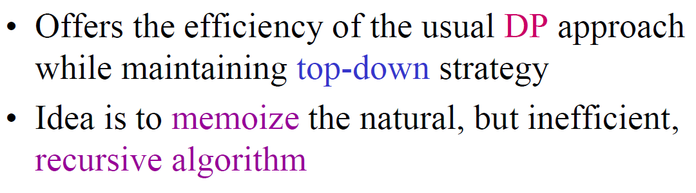
Memoization

Slide 33
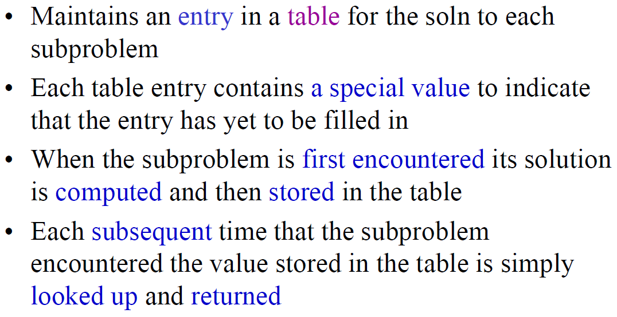
Memoization

Slide 34
Memoized Matrix-Chain
Alg.: MEMOIZED-MATRIX-CHAIN(p)
n ← length[p] – 1
for i ← 1 to n
do for j ← i to n
do m[i, j] ← ∞
return LOOKUP-CHAIN(p, 1, n)
Initialize the m table with
large values that indicate
whether the values of m[i, j]
have been computed
Top-down approach

Slide 35
Memoized Matrix-Chain
Alg.: LOOKUP-CHAIN(p, i, j)
if m[i, j] < ∞
then return m[i, j]
if i = j
then m[i, j] ← 0
else for k ← i to j – 1
do q ← LOOKUP-CHAIN(p, i, k) +
LOOKUP-CHAIN(p, k+1, j) + p_{i-1}p_{k}p_{j}
if q < m[i, j]
then m[i, j] ← q
return m[i, j]

